Slide 1
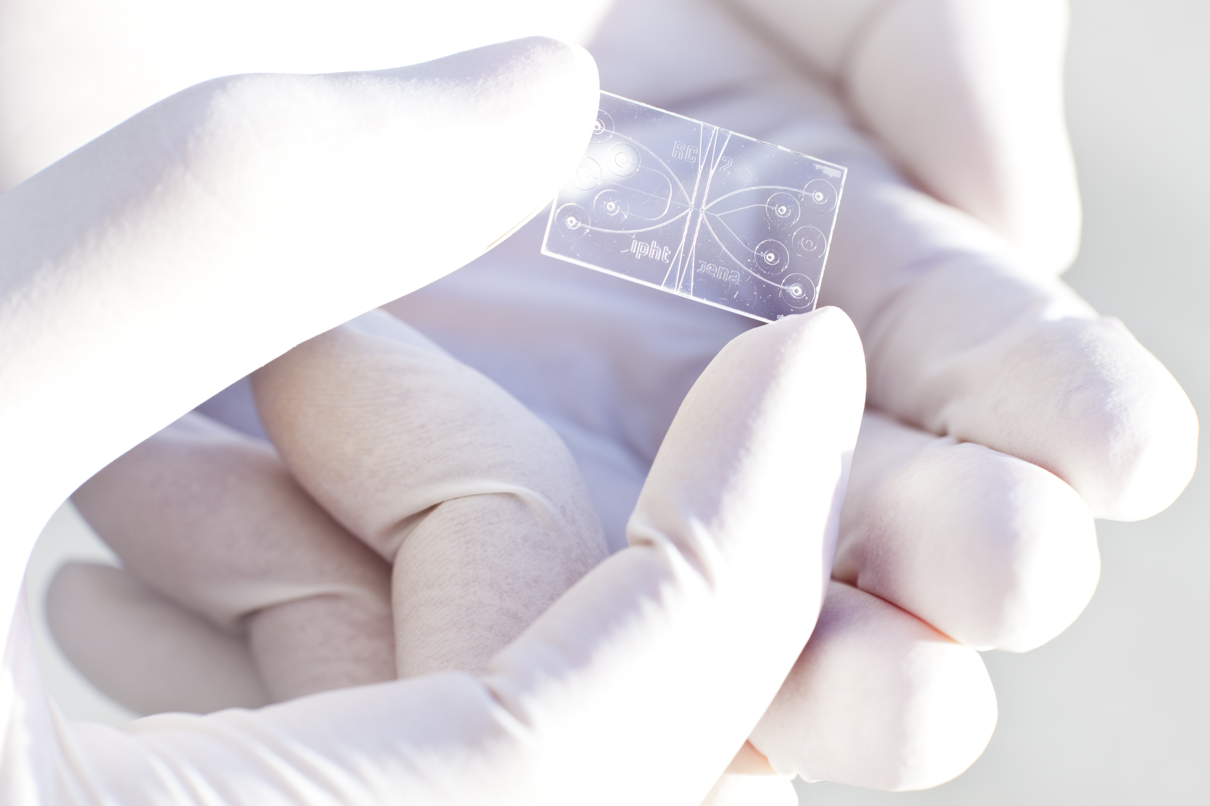



Name Speaker
Institute / University
Date

Slide 2
Raman4Clinics –
Raman-Based Applications for Clinical Diagnostics
Based on Raman Spectroscopy and to overcome currently unmet medical needs it’s our mission to develop novel, label-free and rapid technologies for clinical diagnostics.

Slide 3
A powerful tool for biomedical diagnostics
label-free
non-destructive
in-vivo
rapid
RAMAN

Slide 4
Our Mission
provide new tools for:
  faster diagnosis
  individualized therapy
  reduced treatment costs
  commercialization opportunities

Slide 5
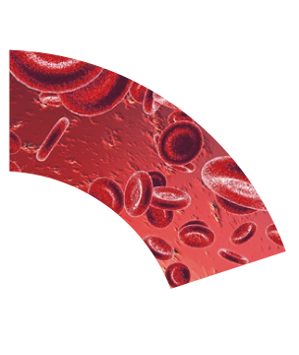

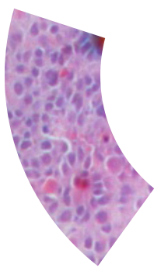


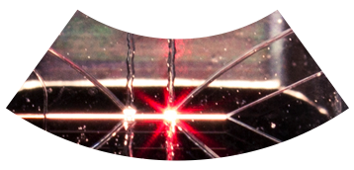
EUROPEAN NETWORK Raman4Clinics
label-free
non-destructive
in-vivo
rapid

Slide 6
Working Group 1:
Therapeutic Drug Monitoring
Fewer side effects through detection of anti-tumoral drugs and antibiotics in body fluids.

Slide 7
Working Group 2:
Diagnosis of Infectious Diseases
Faster and more detailed diagnosis of acute life-threating human infections.

Slide 8
Working Group 3:
Cytopathology of single cells for cancer cell monitoring
Better surveillance of cancer onset and its treatment by detecting tumor cells circulating in blood and urine of cancer patients.

Slide 9
Working Group 4:
Histopathology of Cells and Tissue Sections
Better delineation of tumor margins and determination of tumor type and grade on molecular level, multiplexed spectral biochemical information.

Slide 10
Working Group 5:
Fiber Optic Endoscopy
Fiber optic probes for the assessment of tissues during the resection of biopsies or tumors and intravascular monitoring.

Slide 11
Working Group 6:
Outreach to public and industry
Supervision and communication of the success in transferring the scientific results in clinical routine.

Slide 12
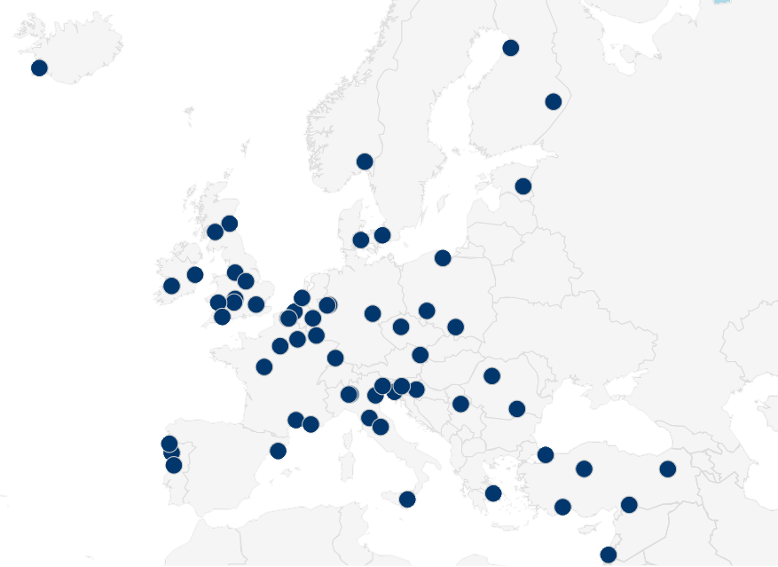
Partner
27 countries
120 research organisations
12 clinics
15 companies
> 160 researchers

Slide 13
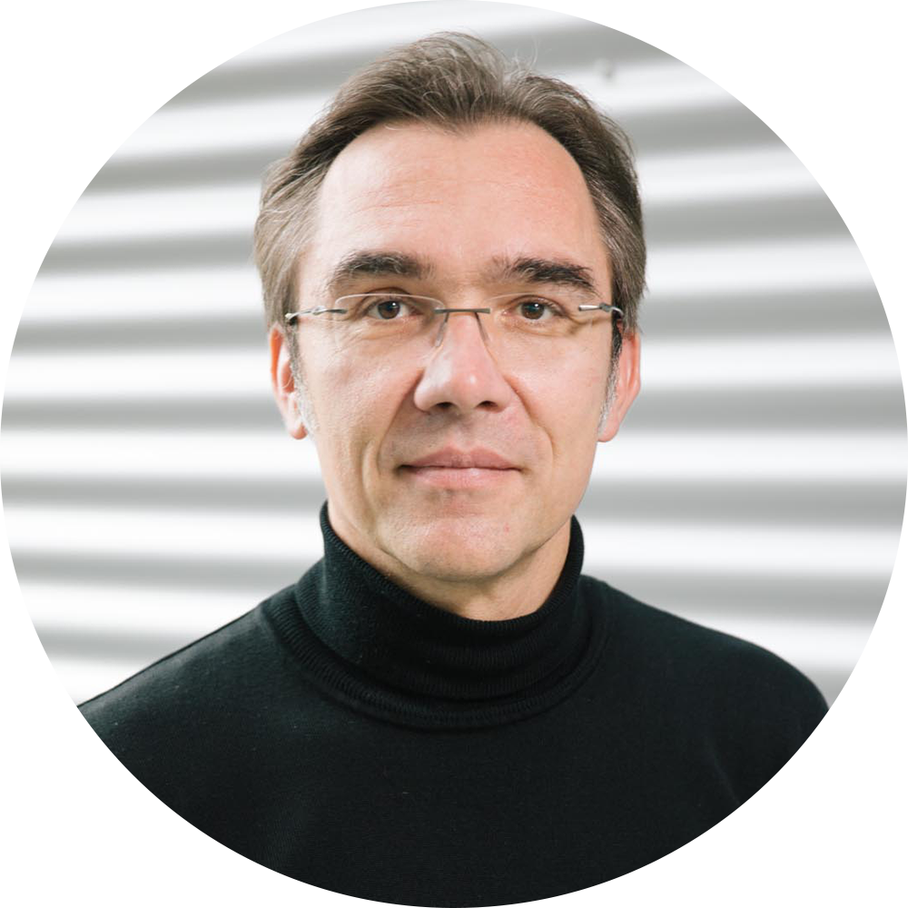
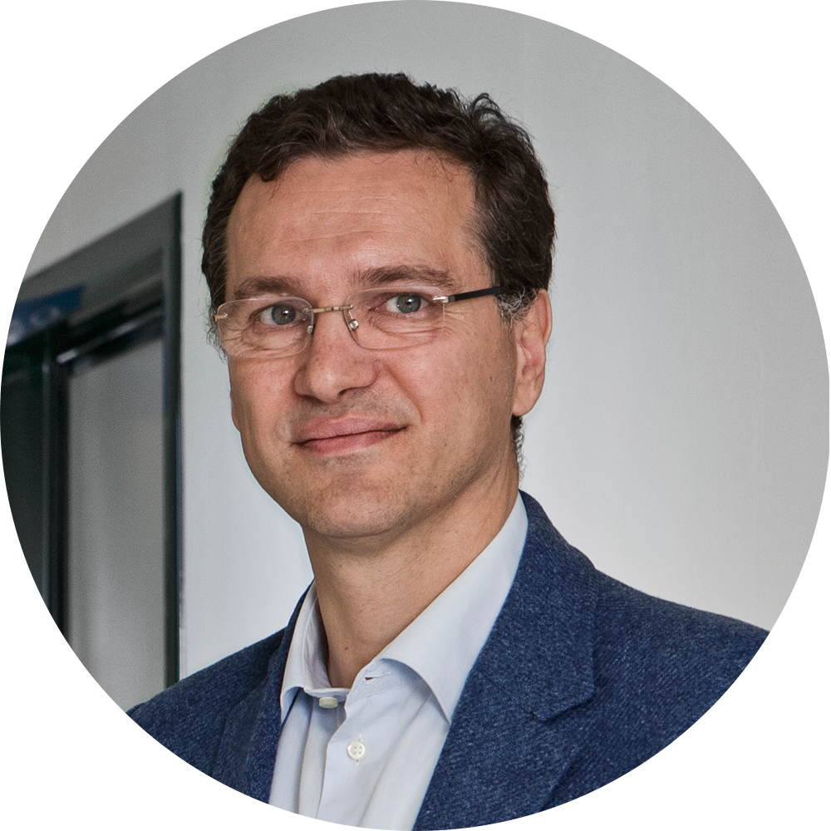
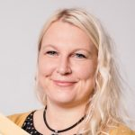
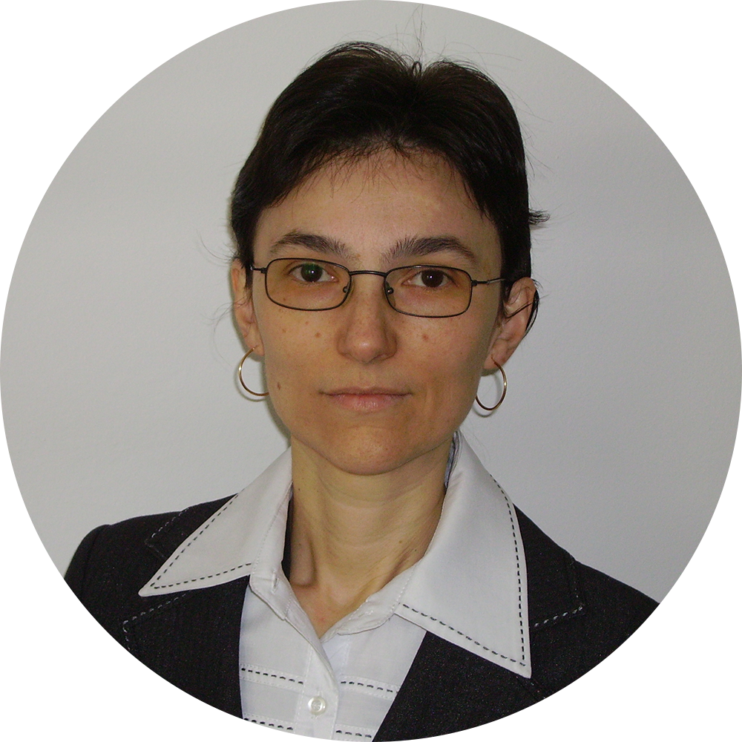
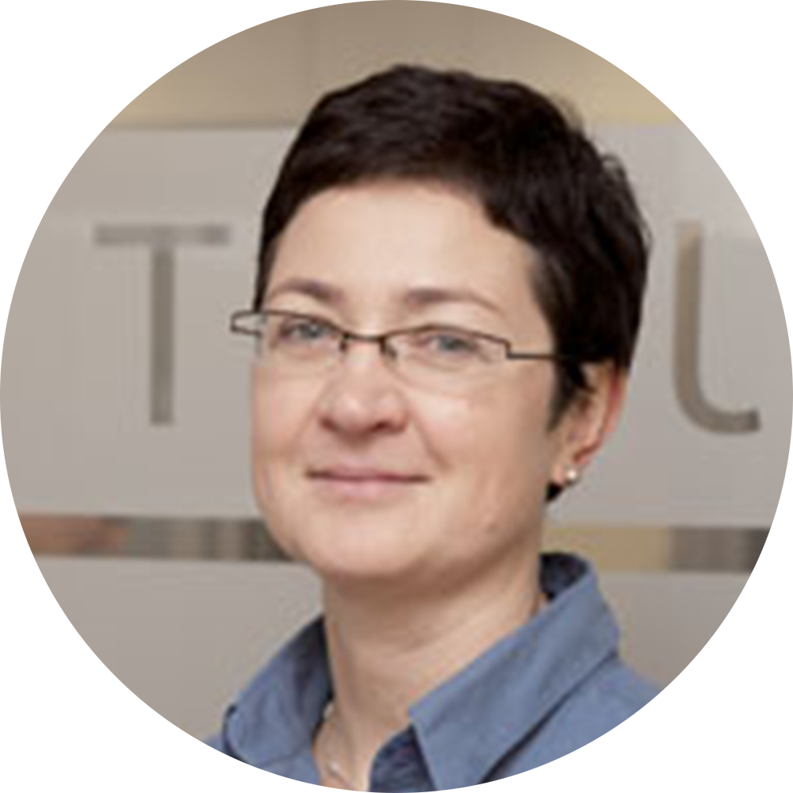
Administration
Jürgen Popp
Chair
Francesco Pavone
Vice-Chair
Gabi Hamm
Grant Holder
Monika Baia
Gender Coordinator
Malgorzata Baranska
STSM Coordinator

Slide 14
Thank you 4 your attention!
For more information please have a look at
www.raman4clinics.eu

